Slide 1
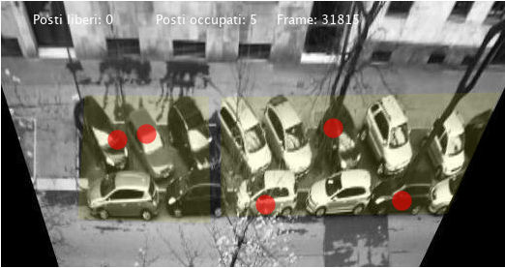
Parking Place Detection
Image Analysis and Computer Vision (2019-2020)
Marco Baratta – 10520788 - 920391

Slide 2
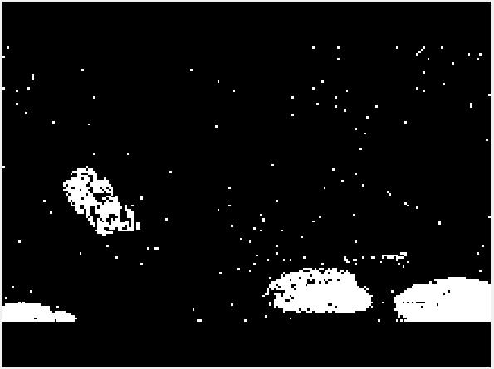
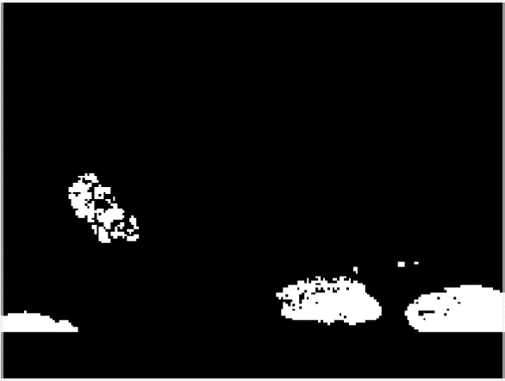
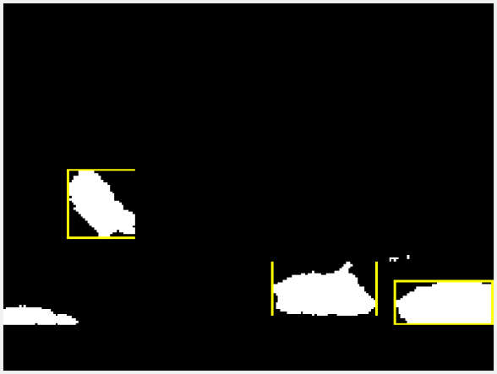
What has been done already:
Foreground detection and blob analysis
Detection of vehicles based on
areas of pixels in the foreground

Slide 3
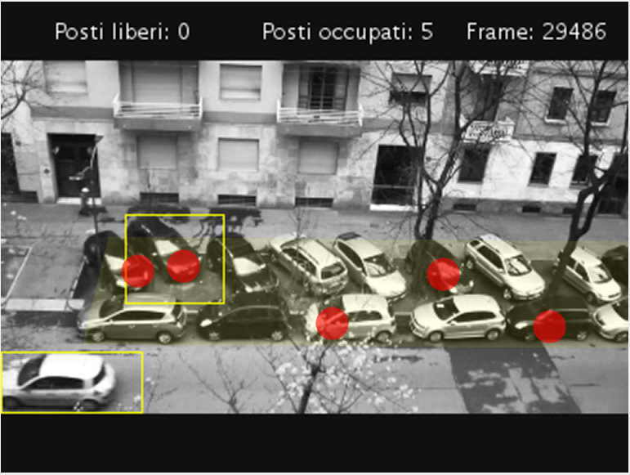
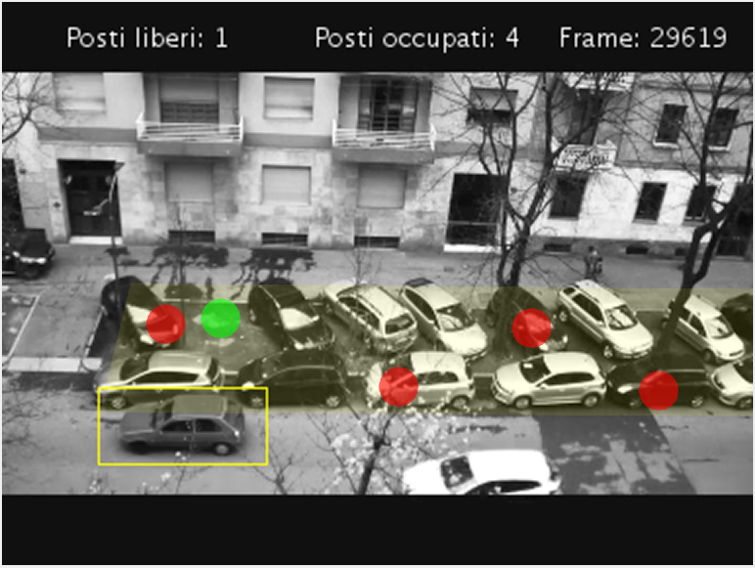
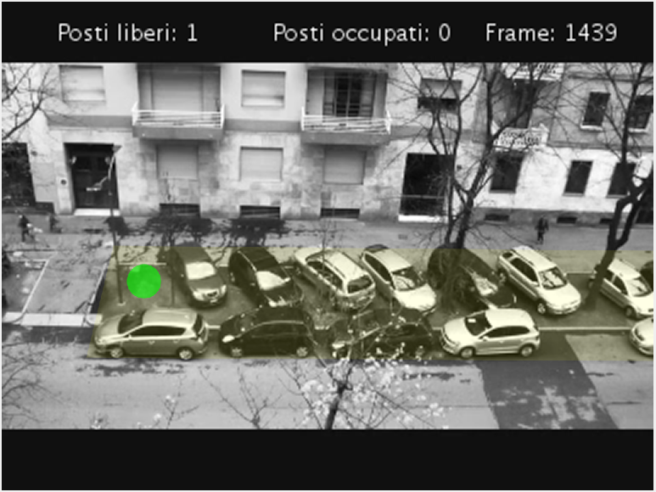
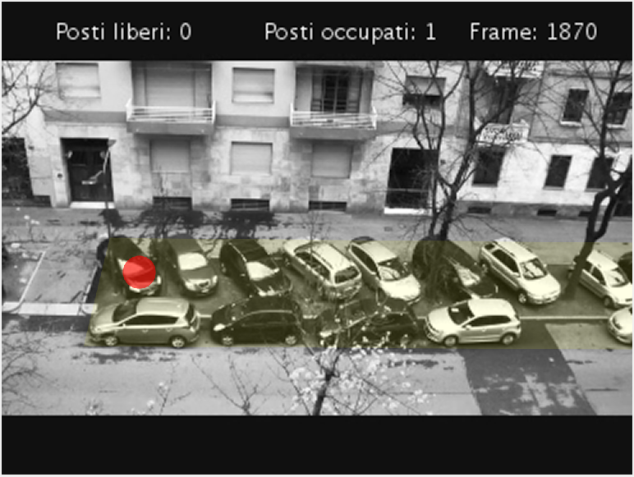
What has been done already:
How much a
Bbox of a vehicle
overlaps parking
area
Monitoring of parking places

Slide 4
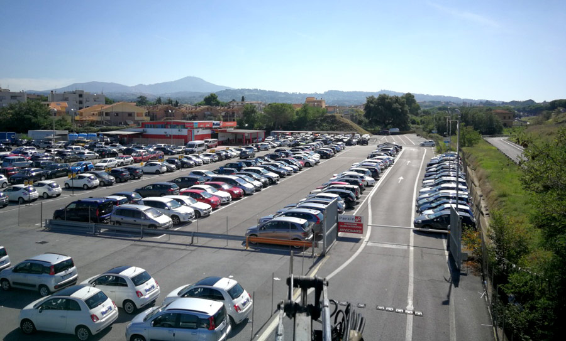
What to do if the area is wide?
Perspective makes distant cars smaller
then closer ones: how to define the right area for blob analysis?
Multiple parking areas: how to compute the overlapping grade?

Slide 5
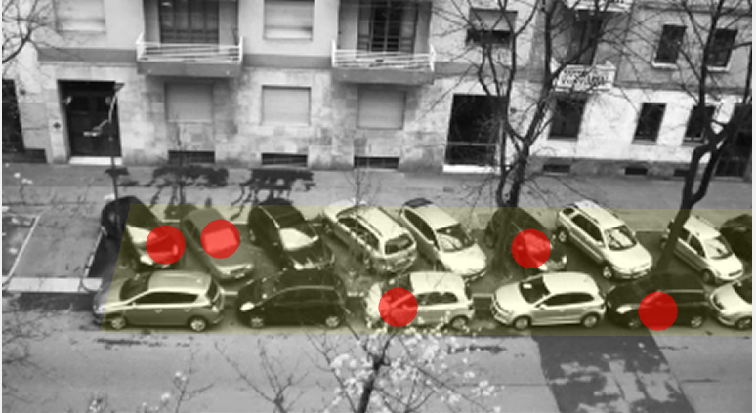
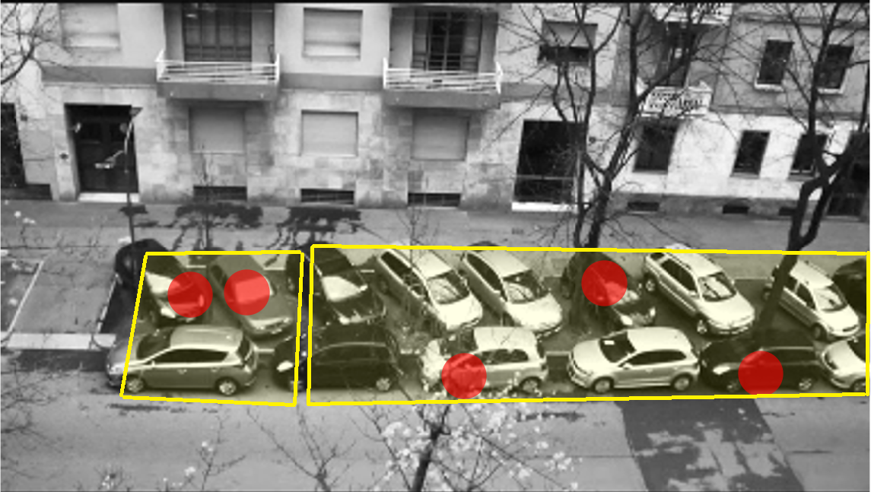
Multiple parking areas
One area saved in only one variable
Multiple areas saved in an array
User draws each area just like before…
…But now, we use an array for the coordinates of each area
Using a loop for computing the overlapping grade (the max is chosen)

Slide 6
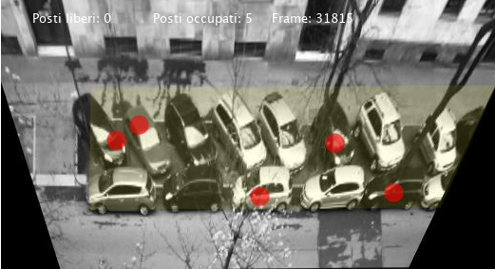
Video rectification
We use a direct method following two transformations

Slide 7
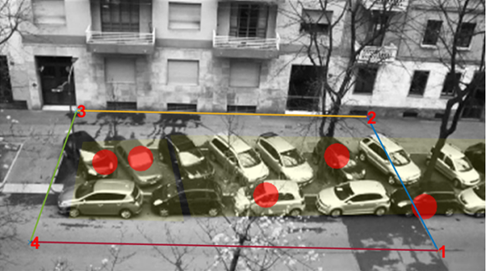
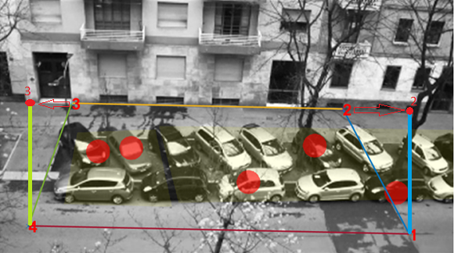
First step
Find 4 points on the image representing a rectangle in the scene
Map two of those points to form a rectangle in the image = homograpy

Slide 8
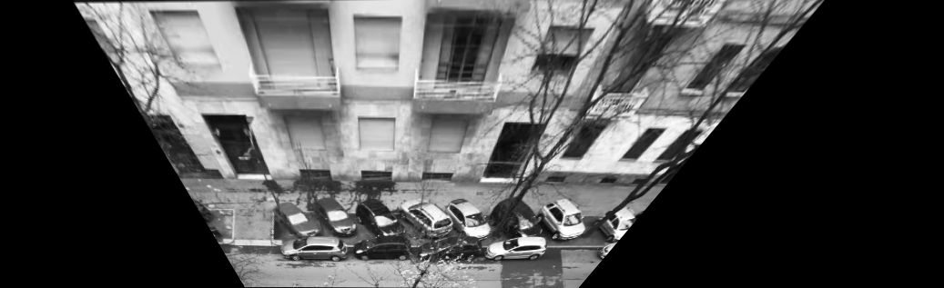
Result of first step

Slide 9
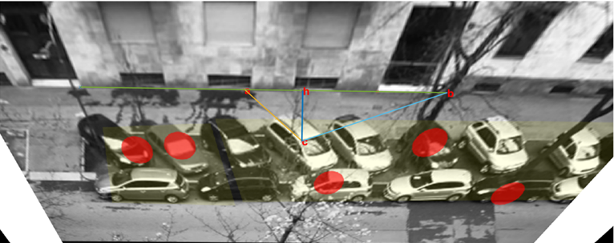

Second step
Detect a different angle that is right in the scene (car rack).
This angle forms a triangle with the base of the previous rectangle
Make this triangle a right-angled one. Map
C to C’ = affine transformation

Slide 10
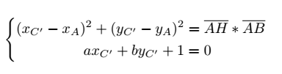
A little of geometry…
A right-angled triangle follows the First Theorem by Euclid
Point C’ lies on the same line (a,b,1)
that goes through C and H

Slide 11
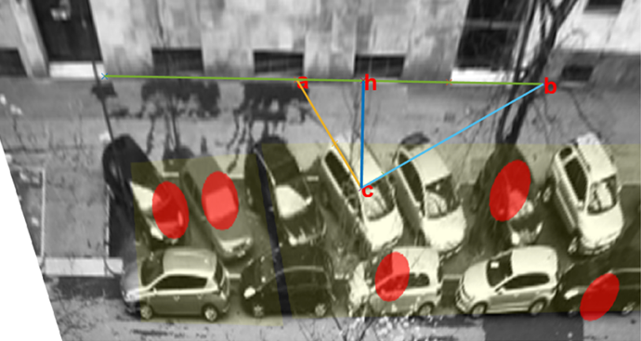
Rectified image
A rectangle and right-angled triangle
Parameters are now constant

Slide 12
What could we improve?
What if we could make the rectification process automatic?
Speed of a moving object is different in a non-rectified image…
…cars in the background move differently from those in the foreground

Slide 13
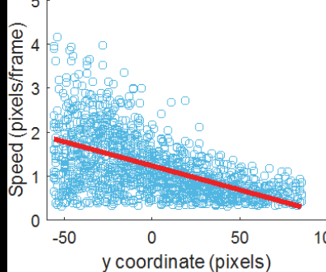
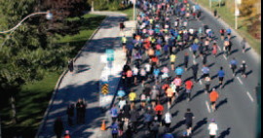
Optical flow – Tilt angle estimation
Objects moving
Optical flow of a frame
Optical flow magnitude (speed)
dependent with vertical coordinate
Estimate tilt angle of the camera with optical flow
In a rectified image, no dependence between optical flow magnitude and vertical coordinates onf the image

Slide 14
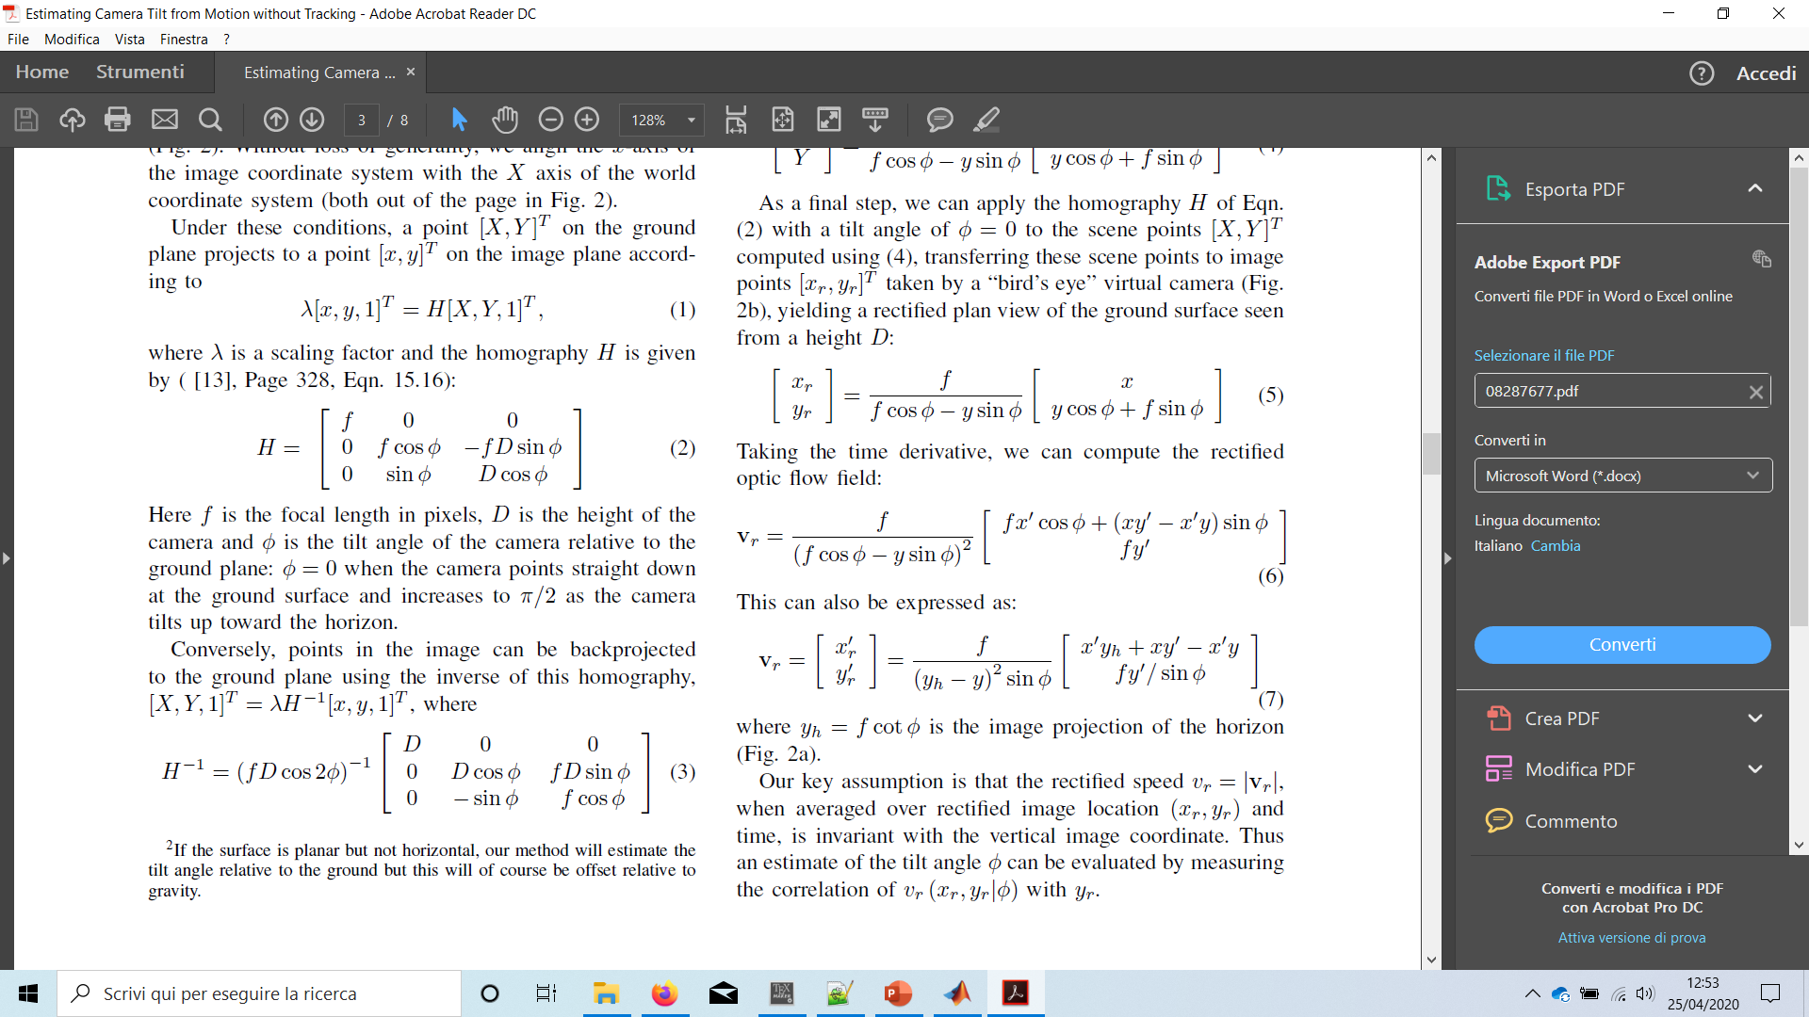
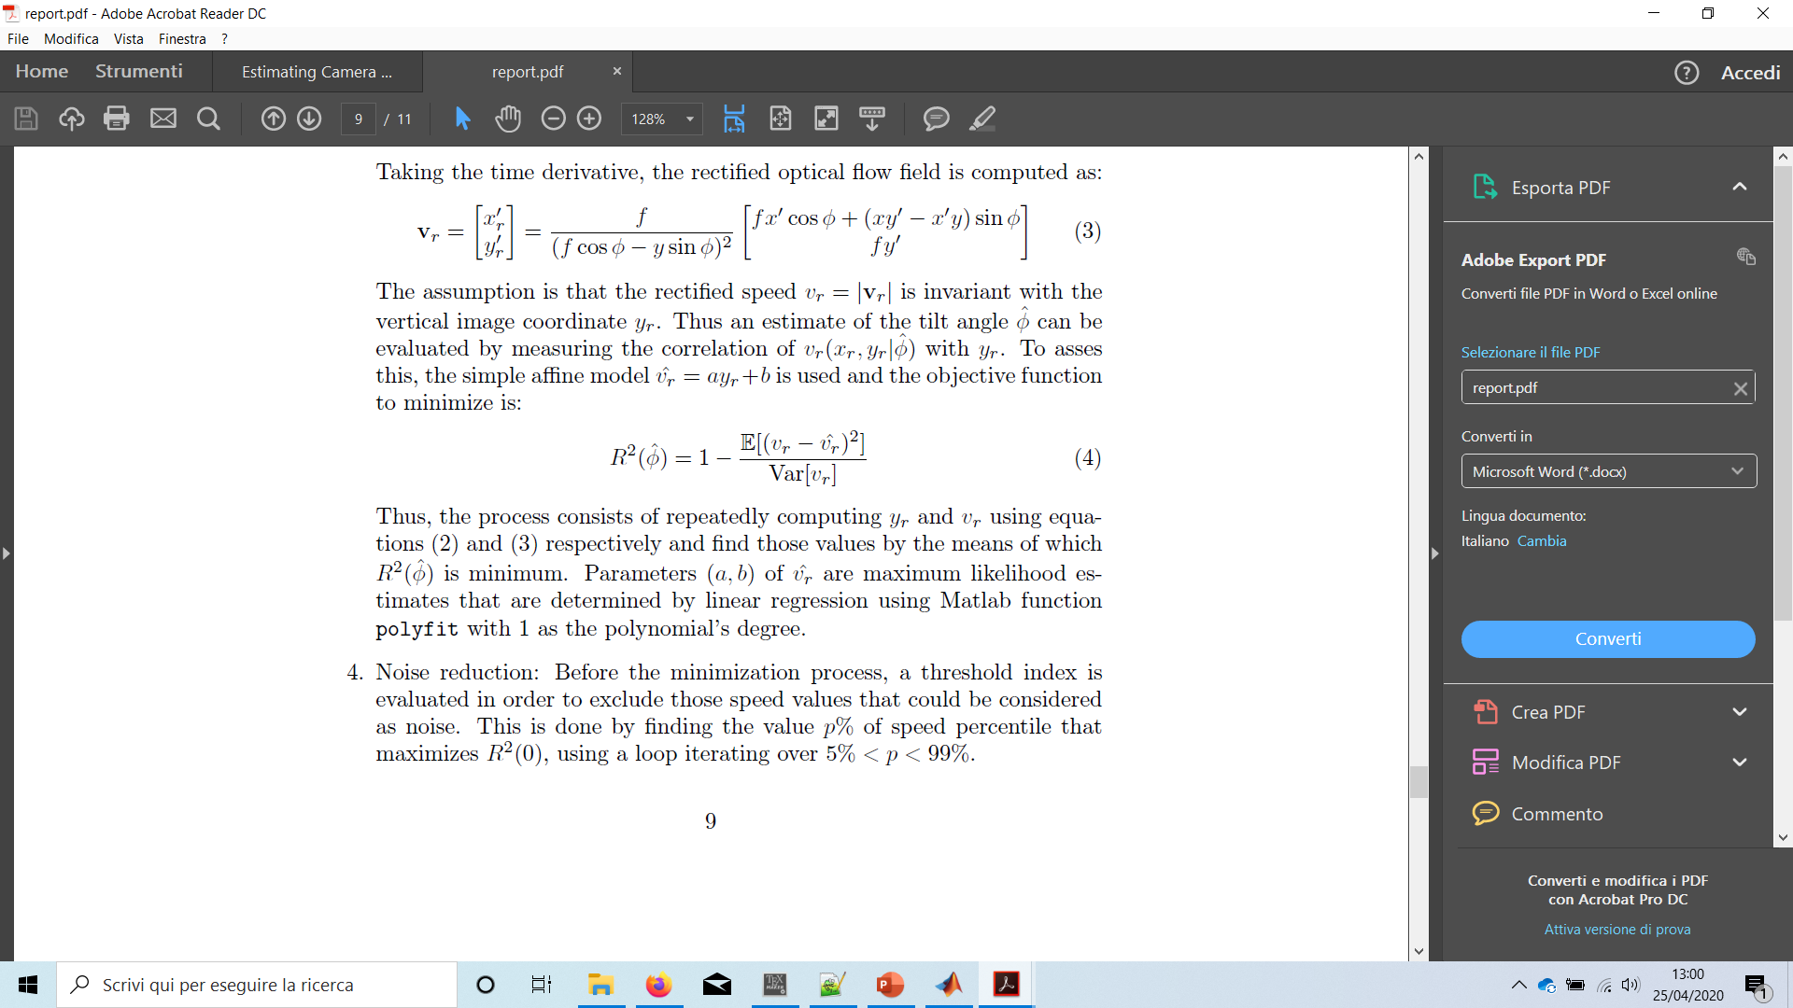

Minimization process
Compute the optical flow of a certain number of pixels.
Use the following formulas to compute the rectified speeds and vertical coordinates
Find the angle $\hat{φ}$that minimizes
Affine model

Slide 15
Future improvements
Use estimated tilt angle to compute image rectification
What to do if a car is at the limit of overlapping grade?

Slide 16
Thank you for your attention

